Slide 1
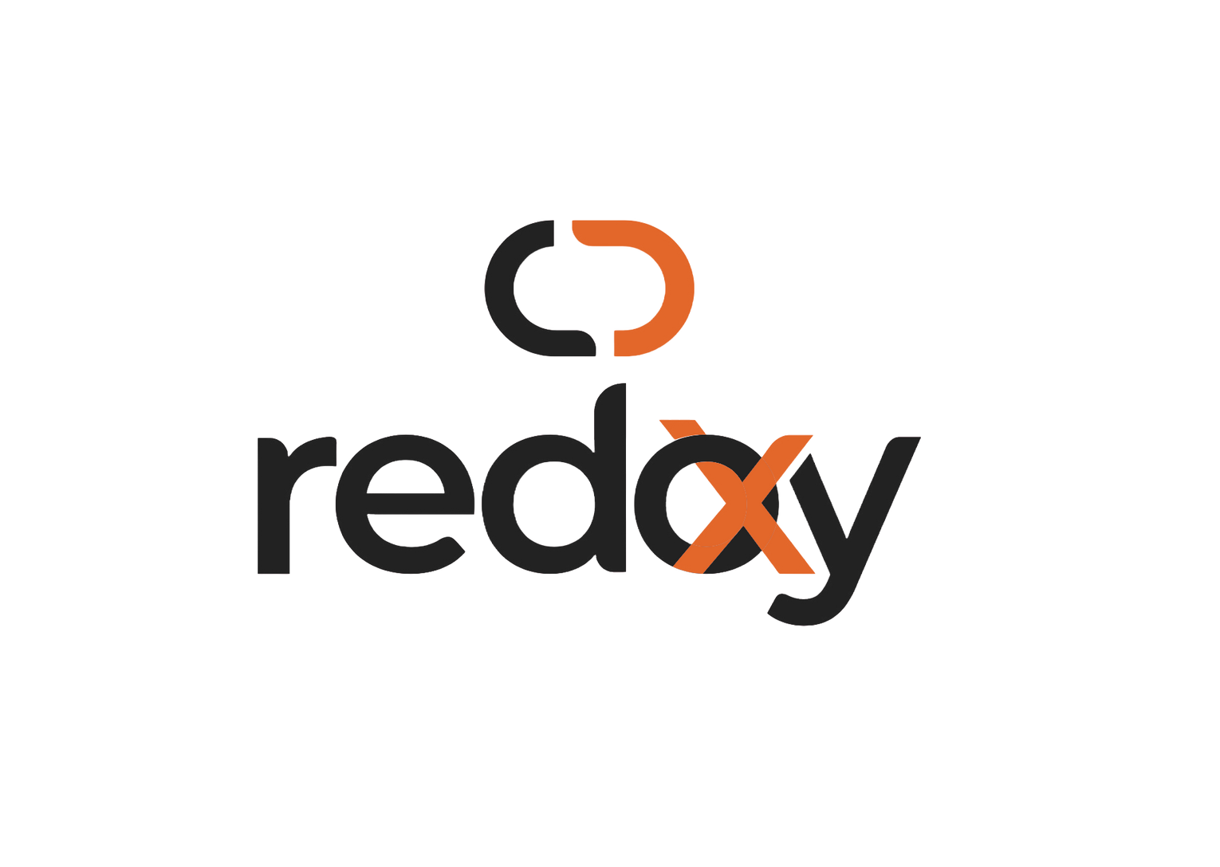

Smart, clean solutions for a better tomorrow.
+971 50 420 0717
+966 53 378 6083
7766 Omar Bin Abdulaziz Street Al Danah,
Jubayl 35514, Saudi Arabia
www.redoxyksa.com
7766 Omar Bin Abdulaziz Street Al Danah,
Jubayl 35514, Saudi Arabia
www.redoxyksa.com
1

Slide 2
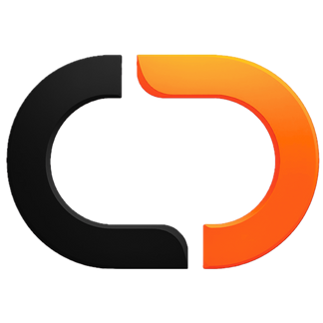

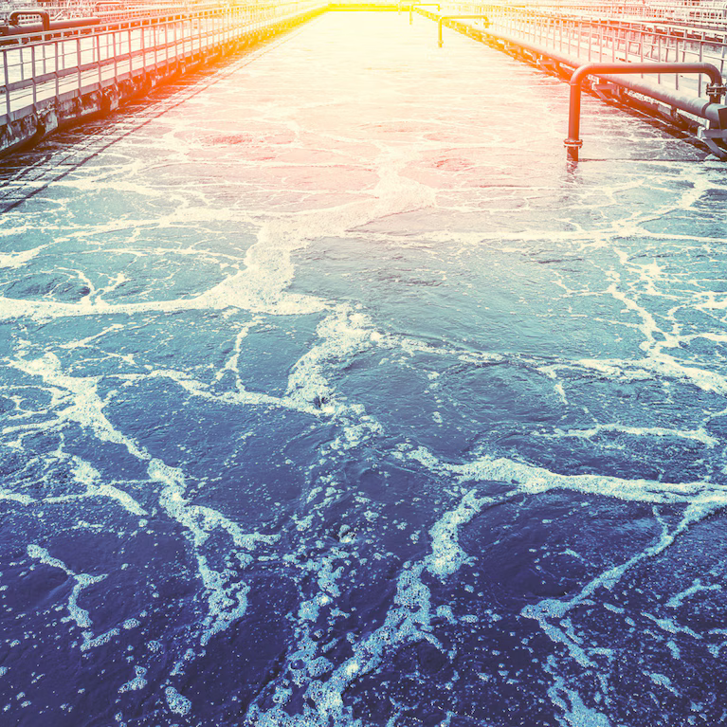
THE OBJECTIVE
At Redoxy, we are committed to creating a cleaner and more sustainable environment for present and future generations. As a leading environmental and waste management company in Saudi Arabia, we specialise in providing innovative solutions and research and development for waste reduction, treatment, and environmental protection.
SUSTAINABLE SOLUTIONS
FOR A GREENER FUTURE!
2
1
www.redoxyksa.com

Slide 3
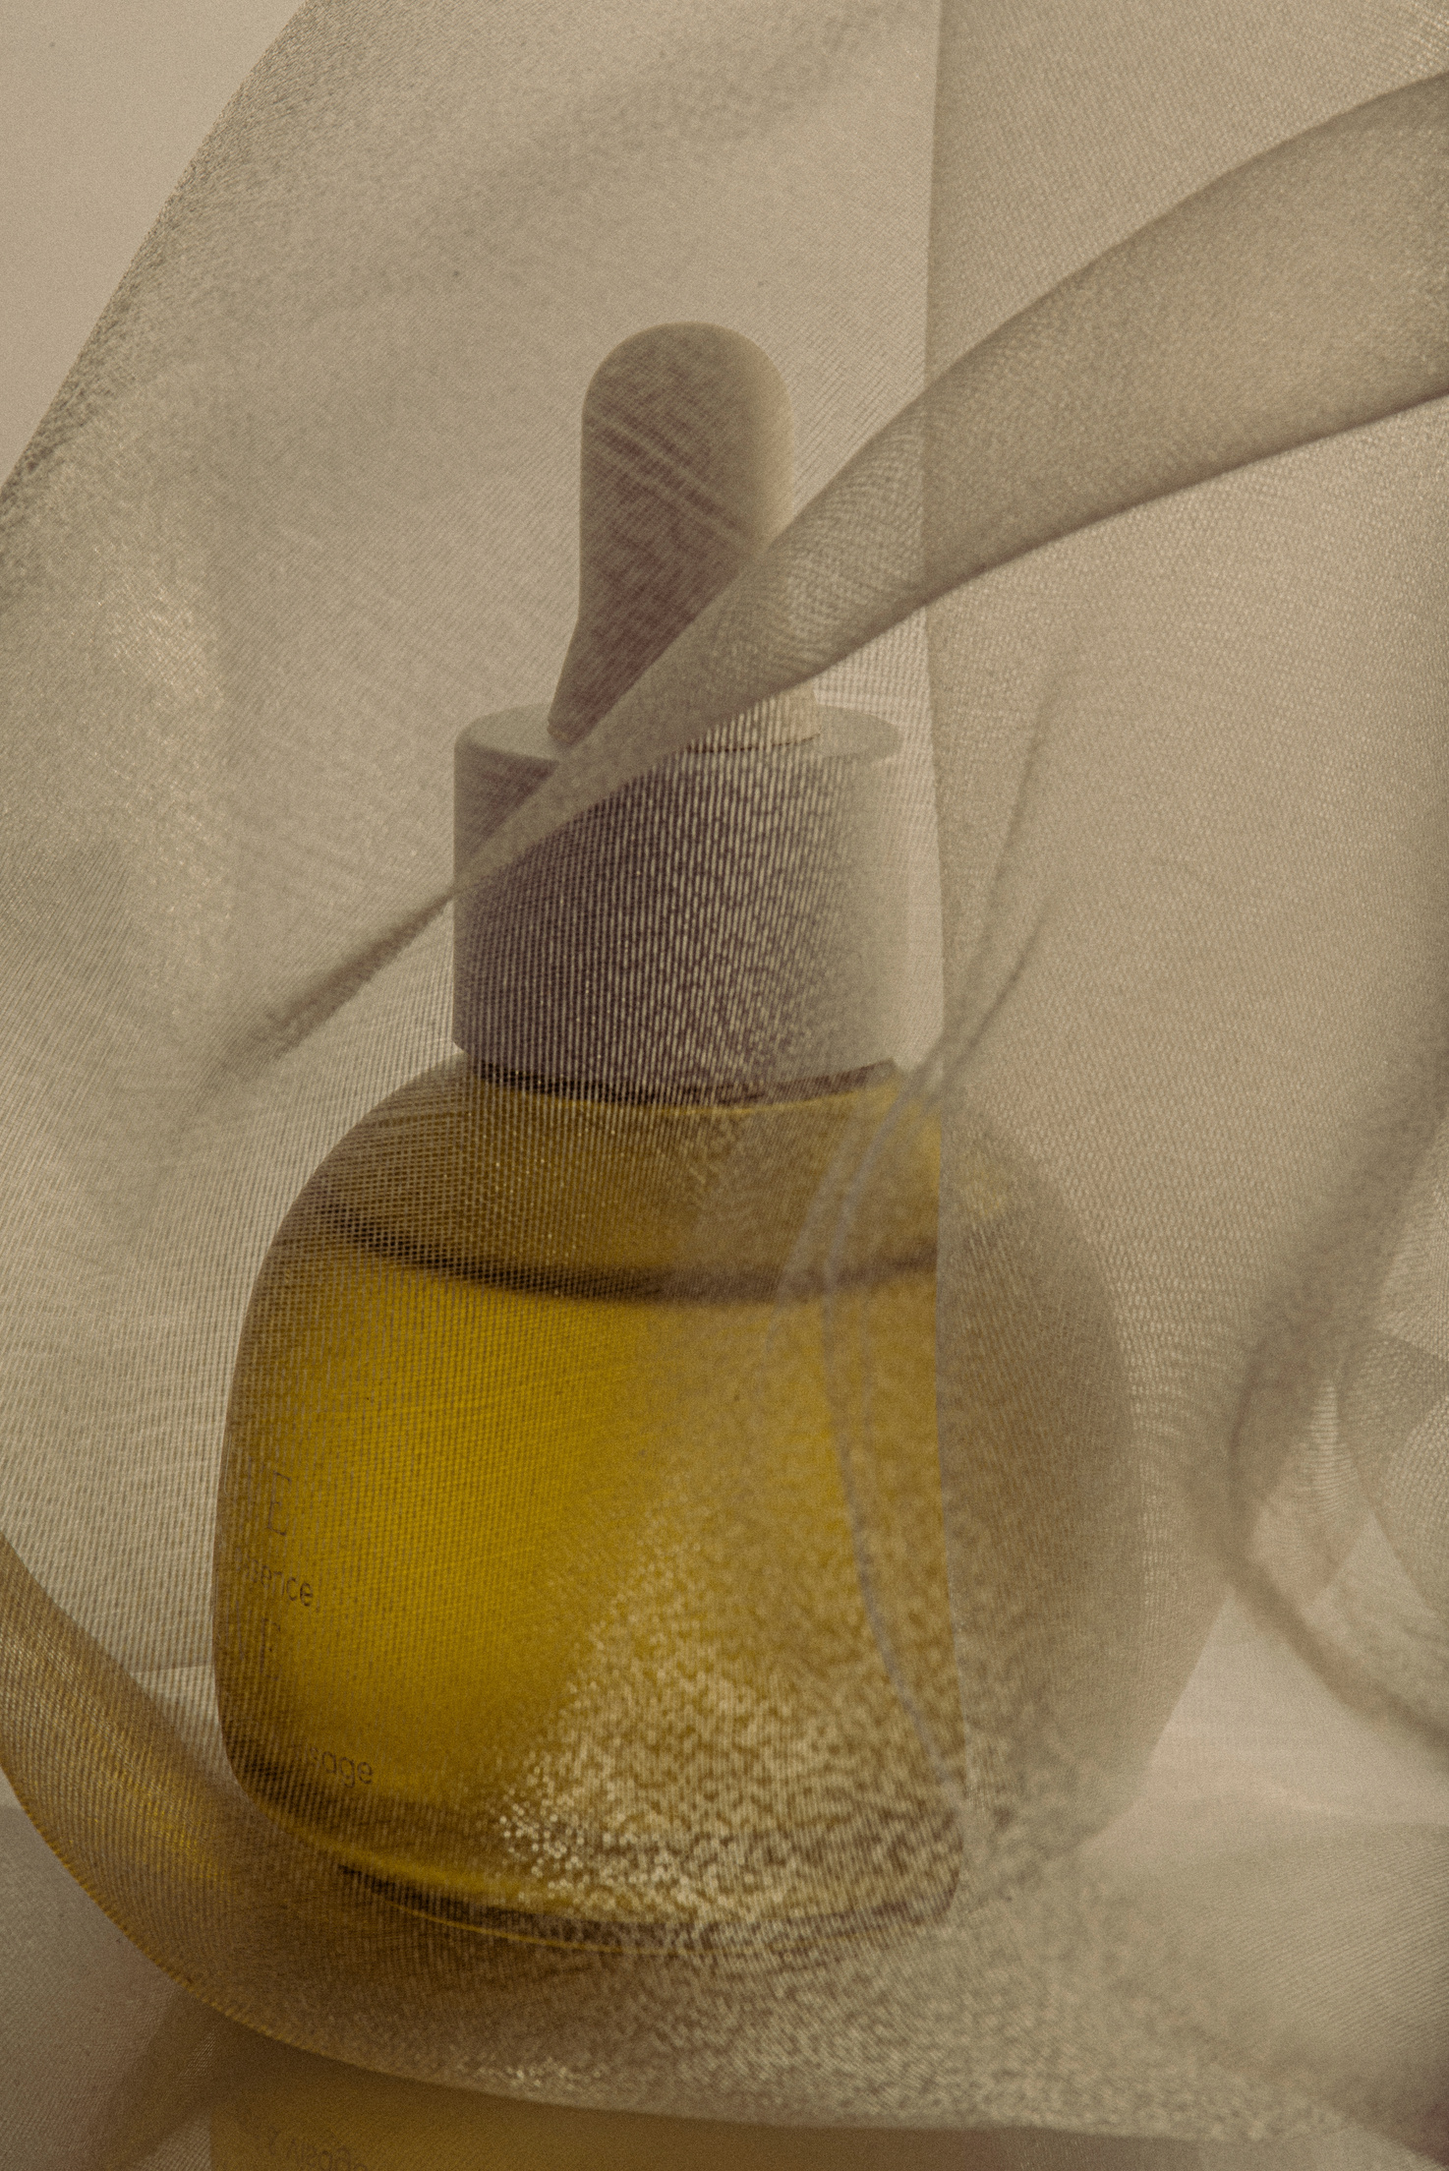
CREATIVE BRIEF
WHY CHOOSE US
Our team of experienced professionals is dedicated to finding the best solutions for your environmental challenges.
EXPERT TEAM
INNOVATION
We stay ahead by adopting the latest technologies and practices in waste management.
SUSTAINABILITY
We are committed to reducing the environmental impact of waste and promoting sustainable living.
3
2
www.redoxyksa.com

Slide 4
OUR MISSION
OUR VISION
Our mission is to revolutionize waste management in Saudi Arabia by providing innovative and sustainable solutions that minimize environmental impact. We are dedicated to transforming waste into valuable resources, fostering cleaner communities, and contributing to a greener future for generations to come.
Our vision at ITCC is to lead the way in setting new standards for waste management excellence. We aim to be the preferred partner for businesses and communities seeking responsible waste disposal and recycling solutions. By leveraging cutting-edge technology, fostering partnerships, and promoting environmental awareness, we strive to create a cleaner and more sustainable Saudi Arabia
4
3
www.redoxyksa.com

Slide 5
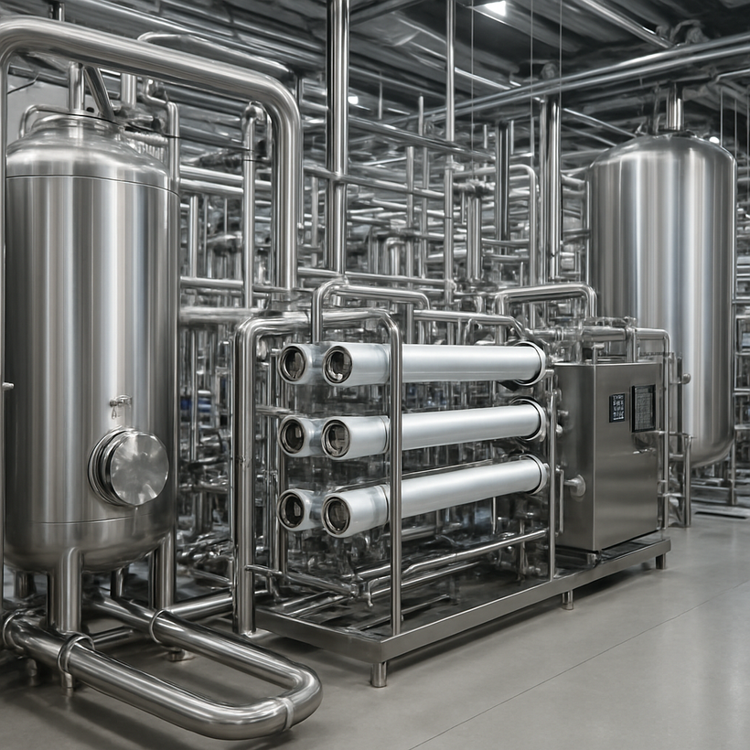
ACTIVITIES
WASTE WATER TREATMENT
ENVIRONMENTAL SUPPORTS SERVICES
Advanced chemical oxidation
Reverse Osmosis
Vacuum Evaporation
Electro oxidation
Oil and sludge treatment
Hazardous waste handling and cleaning
Industrial wastewater evaporation
Dewatering service
Hazardous waste transportation
Tank and pond cleaning
Sludge removal
Equipment service and maintenance
5
4
www.redoxyksa.com

Slide 6
INDUSTRIAL SERVICES
• Chemical Cleaning – Boilers, reactors, exchangers, metallic pipes
(CS, SS ) , oxygen pipelines, Spool dipping chemical cleaning
(see attached chemical cleaning pptx)
• Blasting & Painting of Pipelines, Storage Tanks, Structures etc.
(API standard)
• Hydro milling and hydro jetting cleaning of the pipeline, trench line,
pits, ponds and tanks.
• Steam tracing for oil pipelines.
• Repair / Crude oil washing of Tanks & Silos as per API 650 stan
dards and approved drawings .
• Hydraulic Bolt torquing and tensioning, On-site Machining.
6
5
www.redoxyksa.com

Slide 7

OTHER SERVICES
• Fabrication and installation of pipelines.
• Maintenance of rotary and static equipment in refineries,
plants which includes fabrication & installation of pipe and
support, steel foundation, electrical installation, Surface
Preparation and Painting
• Equipment Rental - pumps,compressor, generator,Frack Tank,
boiler, etc
• Media replacement - loading and unloading
• Logistic services- road tank, vacuum tank, super sucker, dum
truck and flat bed
• supply of chemicals and buy products
7
6
www.redoxyksa.com

Slide 8
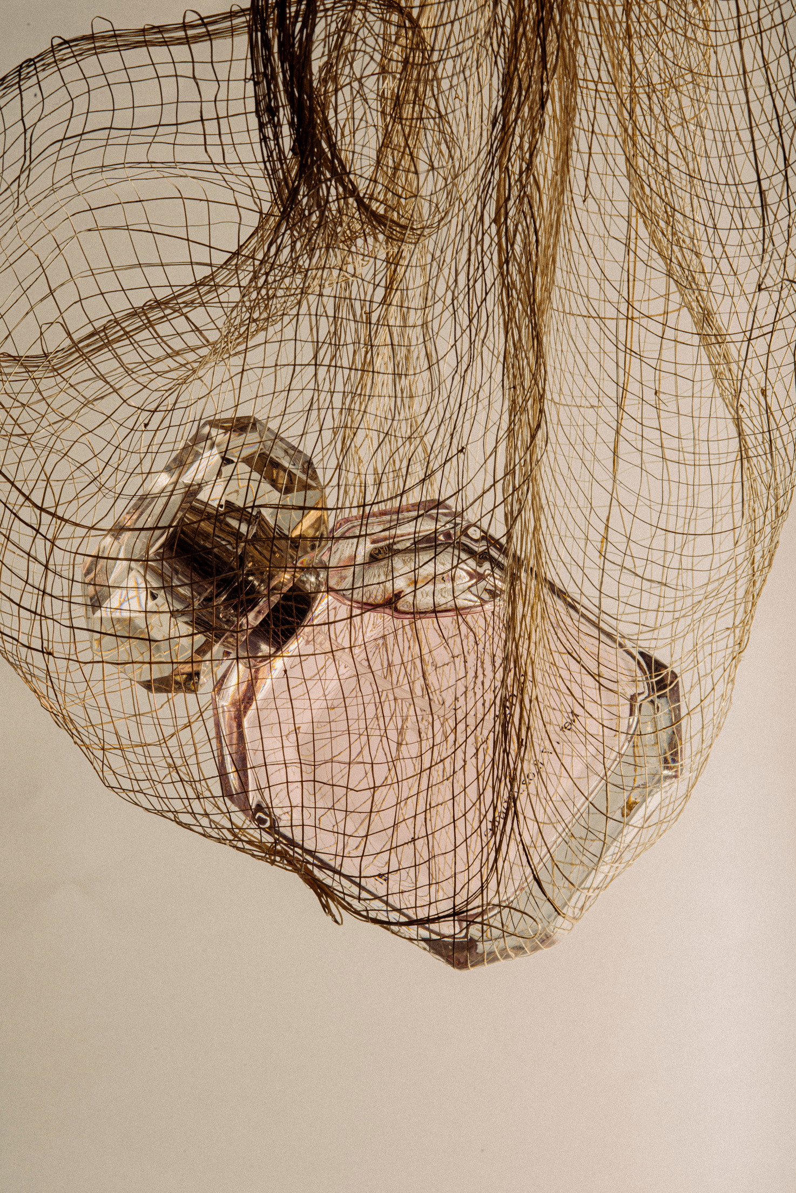
DELIVERING CONSISTENT,
PROFESSIONAL AND HIGHEST
QUALITY INDUSTRIAL SERVICES
8
7
www.redoxyksa.com

Slide 9
9
www.redoxyksa.com

